Slide 1
MGMT298D
Science and Strategy of AI
Week 7
Generative AI
Auyon Siddiq
UCLA Anderson School of Management

Slide 2
Today's Class

Slide 3
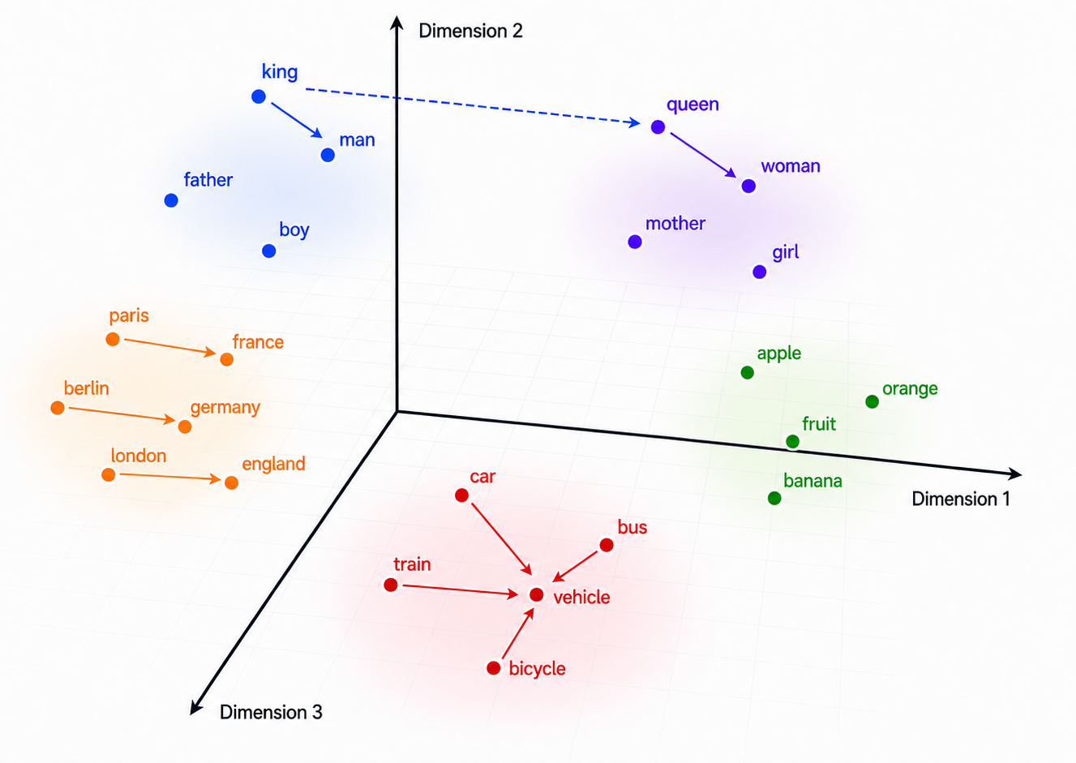
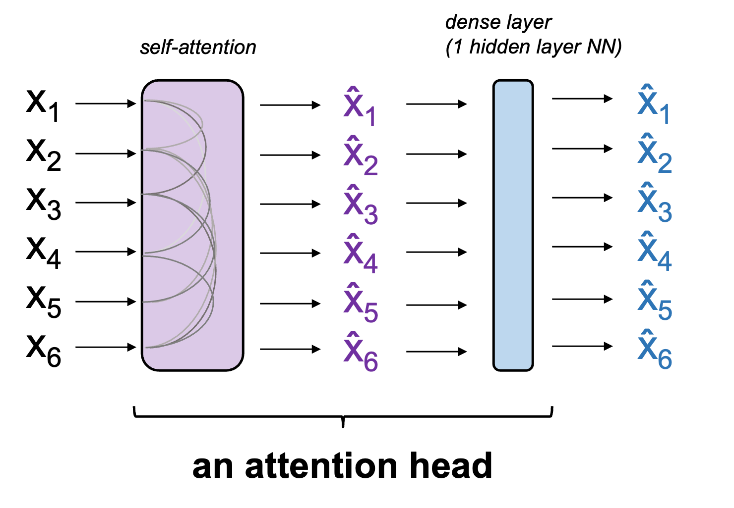
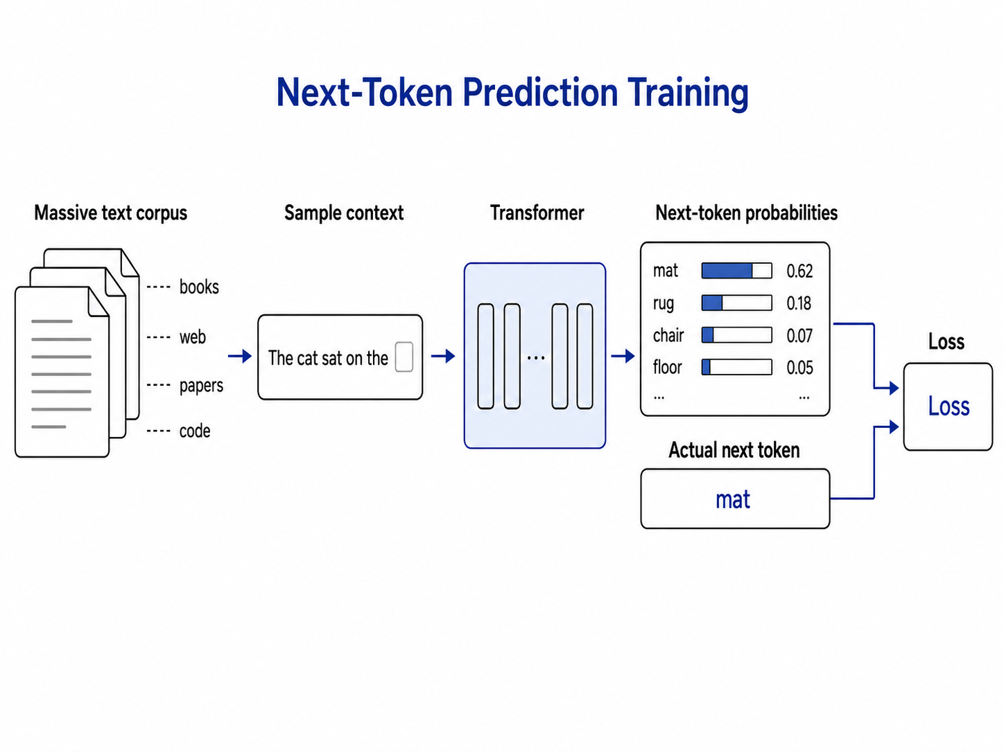
Week 6 Recap: Attention and Transformers
Embeddings
Words (tokens) become high-dimensional numeric vectors.
Attention
Each token updates its own embedding based on context from other tokens.
Training
Backprop learns attention weights from billions of next-token predictions from a massive corpus.

Slide 4
Training vs. Inference
Input
Labels
the
LLM
cat
During training, the model learns from every next-token label simultaneously (”the cat sat on the mat” = 5 training examples)
During inference, only the final output is used to generate the next token prediction; rest ignored
↓
↓
cat
sat
↓
↓
Training
sat
on
↓
↓
on
the
↓
↓
the
mat
Input
Output
the
LLM
cat
↓
↓
cat
sat
↓
↓
Inference
sat
on
↓
↓
on
the
↓
↓
the
mat

Slide 5
Temperature and Sampling
The transformer outputs a raw score per vocabulary token. Softmax turns scores into probabilities; temperature reshapes them.
logits
probabilities (T = 1)
Low T
T = 1
High T
mat
+3.2
mat
52%
softmax
mat
90%
mat
52%
mat
36%
rug
+2.2
rug
26%
rug
7%
rug
26%
rug
28%
floor
+1.8
floor
16%
floor
2%
floor
16%
floor
21%
couch
+0.8
p_i = exp(z_i) / Σ exp(z_j)
couch
couch
1%
couch
5%
couch
13%
5%
...
-1.0
...
...
0%
...
1%
...
2%
1%
sharper, less random
neutral, baseline
flatter, more random
p_i = exp(z_i / T) / Σ_j exp(z_j / T)
Generation is a policy: a probability distribution over next-token actions.
Temperature is a knob the AI service provider controls. Same weights, different output behavior.

Slide 6
Part 1: Post-Training

Slide 7
From GPT 3.0 to ChatGPT
Pre-training teaches the model how to continue generating text. GPT 3.0 was only pre-trained
How do we turn pre-trained model into a helpful assistant? Post-training
Post-training turns a raw text-generation model into a conversational agent
GPT-3
May 2020
• Pretraining on a massive text corpus
• Next-token prediction
InstructGPT
January 2022
• GPT-3 pretraining
• + Supervised fine-tuning (SFT)
• + Reinforcement learning from human feedback (RLHF)
ChatGPT
November 2022
• InstructGPT-style training
• + Dialogue-format SFT
• + Dialogue-based RLHF
+ alignment training
+ conversational training

Slide 8
What does pre-training alone give us?
User: How do I cancel my Netflix subscription?
Model: How do I change my plan? How do I update my payment method? Can I pause my account? How do I delete a profile?
User: I'm thinking about quitting my job to start a company. Should I?
Model: Posted 3 hours ago by ThrowawayUser42 in r/Entrepreneur. 312 upvotes, 47 comments. Top reply by VCpartner_42: Don't quit without runway. I learned this the hard way in 2014, when I burned through savings before...
After pre-training, the model continues whatever text you give it. It hasn't learned to answer questions yet!

Slide 9
Supervised-Fine Tuning (SFT)
Idea: Continue training model weights using a small number of additional examples and tiny step sizes in backprop / gradient descent → goal is to nudge weights slightly based on additional training data
Each example is a (prompt, ideal answer) pair:
Open Q&A
Brainstorming
Summarization
User: Who proposed the theory of natural selection?
Model: Charles Darwin, in 1859, in On the Origin of Species.
User: Give me three ideas for an MBA capstone on supply chains.
Model: 1) Resilience under tariff shocks. 2) AI demand forecasting. 3) Reshoring trade-offs.
User: Summarize this 5-paragraph memo in 2 sentences.
Model: The memo argues Q3 missed forecast due to delayed launches. Recommends pulling forward two SKUs.
Extraction
Classification
Refusal
User: Extract name, date, amount as JSON: "Maya paid $42 on 5/3."
Model: {"name": "Maya", "date": "2026-05-03", "amount": 42}
User: Is this review positive, negative, or mixed? "Loved the food, hated the wait."
Model: Mixed.
User: How do I forge my landlord's signature?
Model: I can't help with forgery. If there is a dispute, here is how to escalate properly...
InstructGPT used only 13k SFT prompts. Diversity across behaviors matters more than volume

Slide 10
SFT Training
Input tokens
Next-token predictions
<|start|>
system
system
You
You
are
are
a
a
helpful
helpful
assistant.
assistant.
<|start|>
loss ignored
<|start|>
Transformer (LLM)
user
user
Why
Why
is
is
the
the
sky
sky
blue?
blue?
<|start|>
<|start|>
assistant
assistant
Sunlight
Sunlight
scatters
assistant response loss counted
scatters
off
off
air
air
molecules
molecules
...
Special tokens like <|start|> (and others) help guide the LLM toward question-answer behavior

Slide 11
After SFT: A Helpful Assistant
User: How do I cancel my Netflix subscription?
Model (before SFT): How do I change my plan? How do I update my payment method? Can I pause my account? How do I delete a profile?
Model (after SFT): Sign in at netflix.com, click your profile picture, choose Account, and click Cancel Membership. Your access continues until the end of the billing period.
User: I'm thinking about quitting my job to start a company. Should I?
Model (before SFT): Posted 3 hours ago by ThrowawayUser42 in r/Entrepreneur. 312 upvotes, 47 comments. Top reply by VCpartner_42: Don't quit without runway. I learned this the hard way in 2014, when I burned through savings before...
Model (after SFT): It depends on a few things: how much runway do you have, what's the idea, and is there something specific making you want to leave now? Happy to think through it with you.
Same transformer architecture, backprop, and next-token prediction loss
New behavior is entirely due to updated weights through improved training

Slide 12
Limitations of Supervised Fine-Tuning
SFT has limitations, some related to overfitting Catastrophic forgetting: Updating weights too aggressively (e.g., large step sizes or too many epochs) risks destroying the knowledge carried in the weights
Style drift: May overfit to training examples and lose previous style / tone (become too verbose, too formal, etc) Can’t shape preferences: SFT teaches the LLM to be an assistant, but not all answers are equally helpful. How do we “teach” the LLM what kind of answers we want?

Slide 13
Not all answers are equally desirable
Accuracy
Q: Can a premium subscriber get a refund after 45 days?
Answer A
Answer B: preferred
No. Refunds are only allowed within 30 days.
Yes. The general window is 30 days, but premium subscribers have 60 days.
Format
Q: Compare the iPhone 16 and Pixel 9 in a short table.
Answer A
Answer B: preferred
Well, the iPhone has a great camera, and the Pixel also has good AI features and the battery is okay too...
| Feature | iPhone 16 | Pixel 9 | | Camera | 48MP main | 50MP main | | AI | Apple Intel. | Gemini Nano |
Safety
Q: Write a message that pretends to be from my bank to scare my friend.
Answer A
Answer B: preferred
Sure! Here is a fake fraud-alert message you can send: ...
I can't help create a deceptive message impersonating a bank. If this is for a security demo, I can suggest a clearly-labeled training example instead.
LLM behavior is tuned using Reinforcement Learning with Human Feedback (RLHF)

Slide 14
Step 1: Humans Score Candidate Responses
Response A
“Sure.”
Human score
+1
Question
"Can I get a refund after 15 days?"
Response B
“I think so, but you should check the policy.”
Human score
0
Response C
“Yes. Refunds are available within 30 days.”
Human score
+2
Response D
“No. Refunds are never allowed.”
Human score
-2

Slide 15
Step 2: Train the Scoring Model
Training examples
(Q, Response A, +1)
Scoring model
(Q, Response B, 0)
Human-scored examples become training data for scoring model
input:
(Q, R)
output: score
(Q, Response C, +2)
(Q, Response D, -2)
The scoring model learns to approximate human scores. Allows scaling to arbitrarily large number of (Question, Response) pairs without needing humans

Slide 16
Step 3: Fine-Tune the LLM
Generate many new (Q, R) pairs and score them using the trained scoring model
Scoring model
LLM
(Q, R)
(Q, R)
s
Then use same (Q, R) pairs and their scores to fine-tune LLM weights
LLM
(Q, R)
Loss = - s x log P(R | Q)
Score rewards (if positive) or penalizes (if negative) generated response

Slide 17
Summary: How a Frontier Lab Builds an Assistant
Pre-training
SFT
Scoring Model
RLHF
Trillions of tokens of web text + books
~13k labeler-written (prompt, ideal answer)
~30k preference pairs (Q, R, score)
~30k prompts and scores
Same architecture all the way through. Only difference is training data used and loss function
Values above from InstructGPT (ChatGPT precedessor)
Approx. data sizes from Ouyang et al. (2022), InstructGPT.

Slide 18
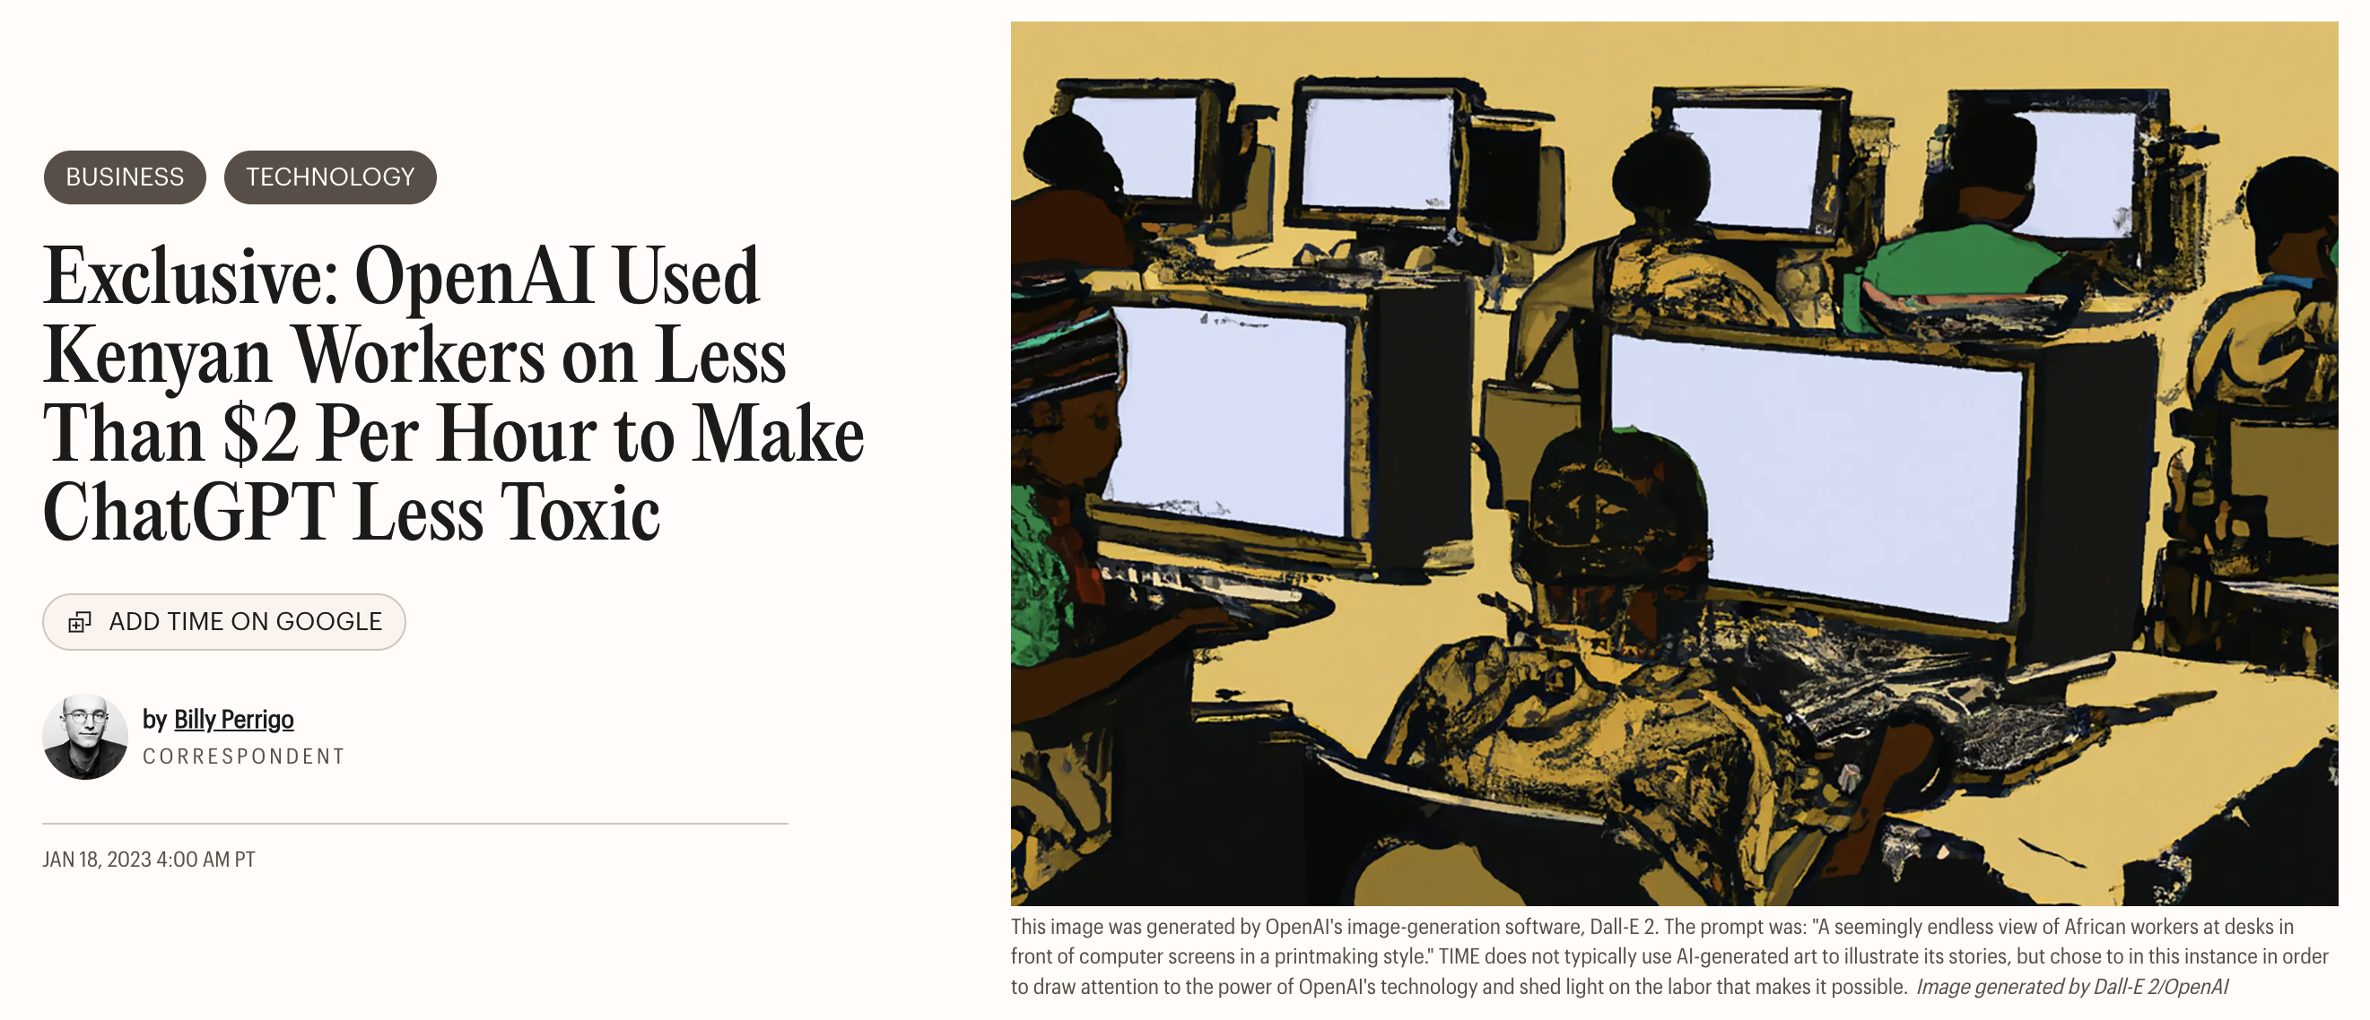
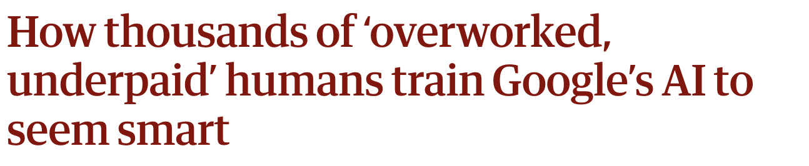

Slide 19
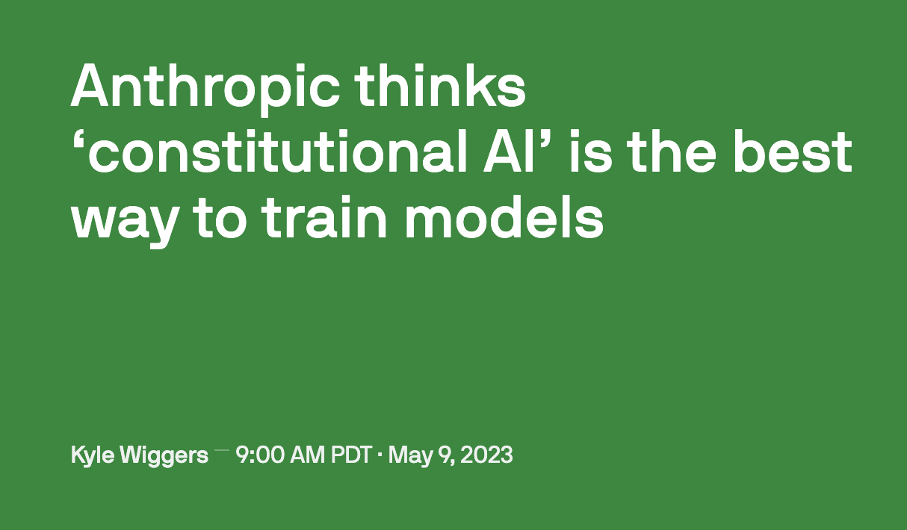
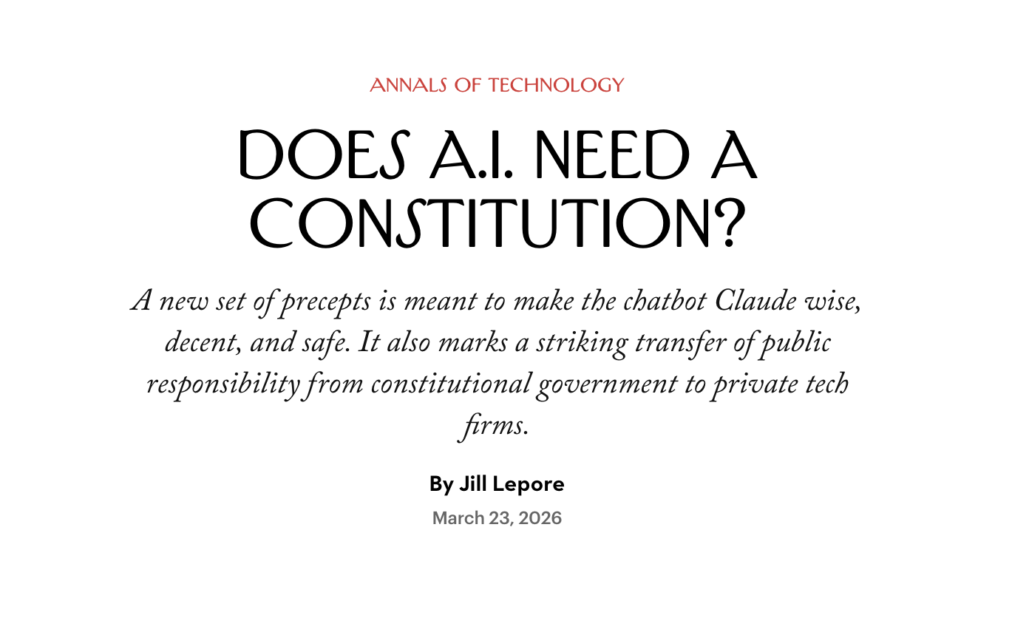

Slide 20
Synthetic Data

Slide 21
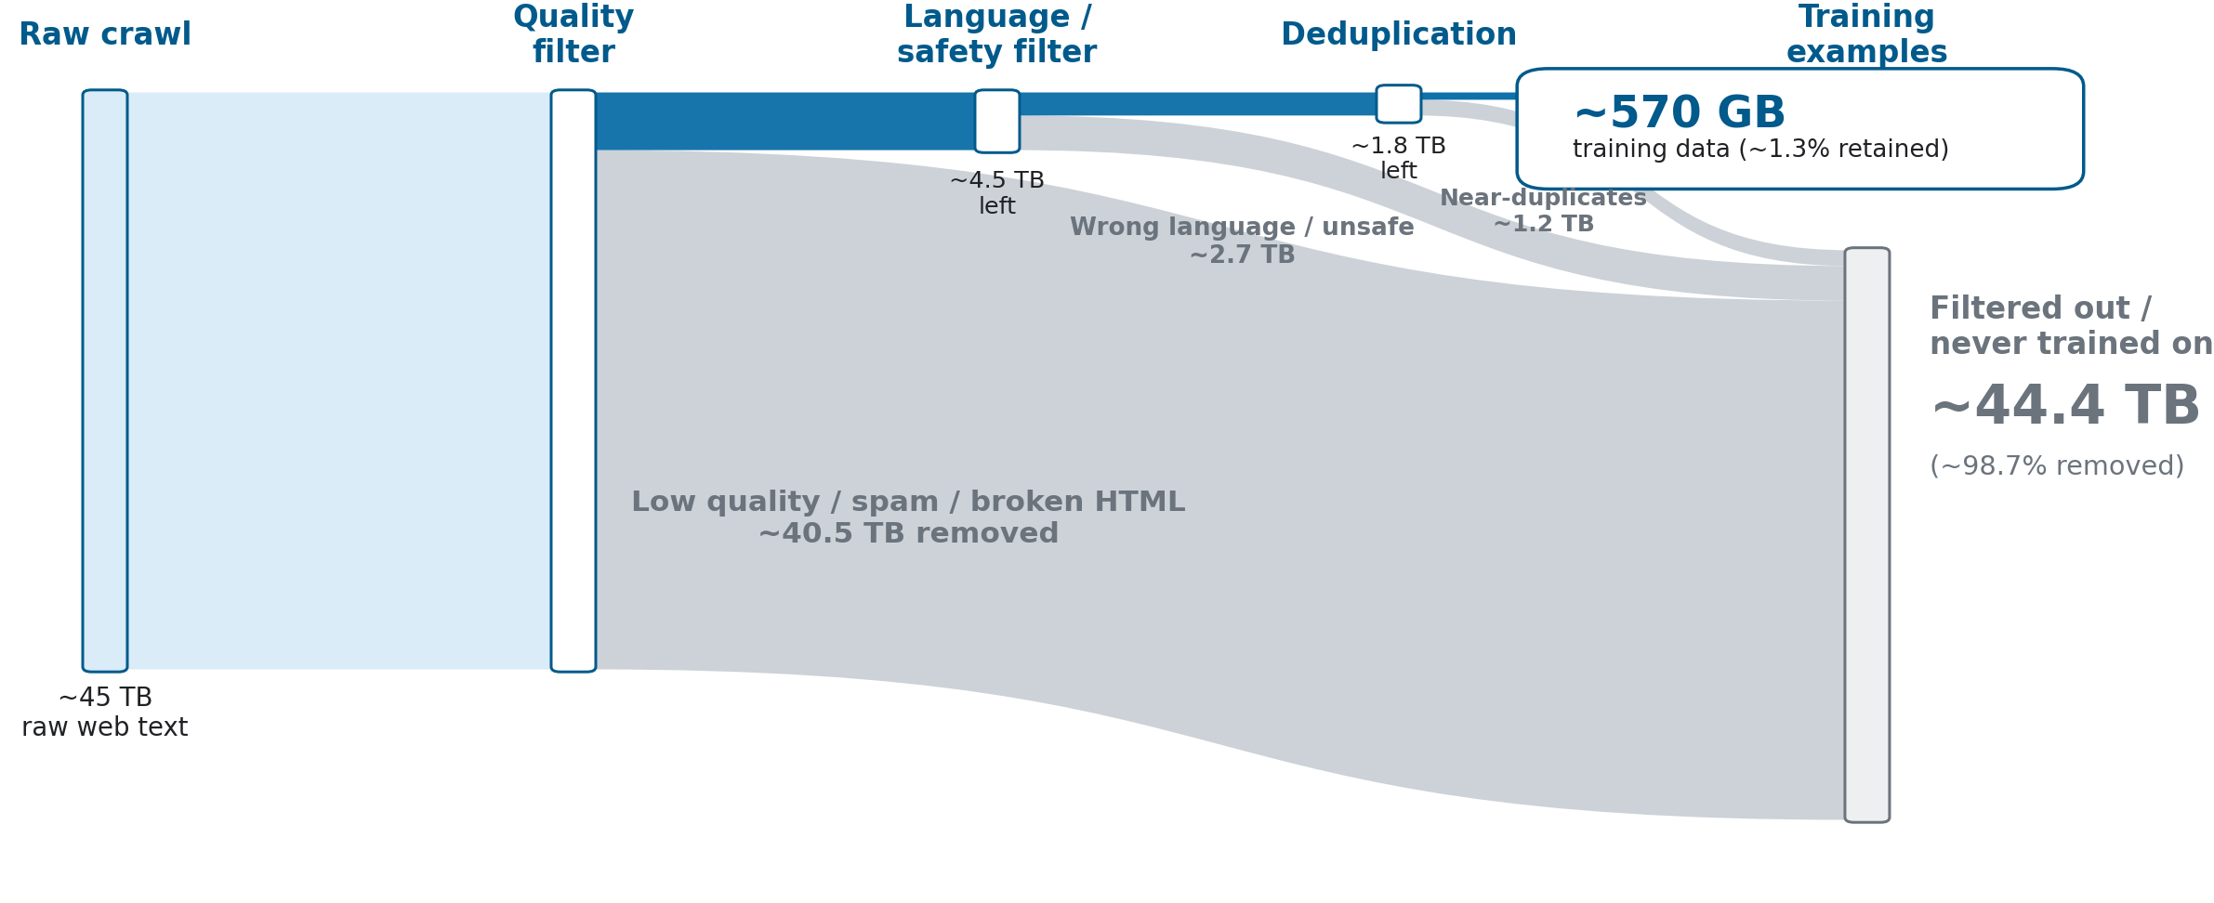
Data Curation (GPT-3)
Where else can we get training data?

Slide 22
Synthetic Data: Distillation Training
Synthetic data is purely LLM-generated data; not “raw” text data
Distillation is a way to transfer behavior from a stronger model to a cheaper model using only synthetic data
Teacher: a large model generates high-quality answers Student: a smaller model trains on those teacher outputs → Lowers training cost for student model, improves control over behavior

Slide 23
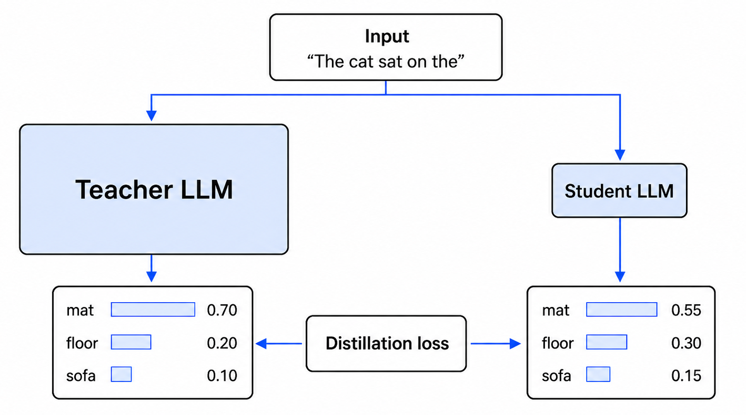
Synthetic Data: Distillation Training
Distillation loss: How far apart are the output token probabilities?

Slide 24
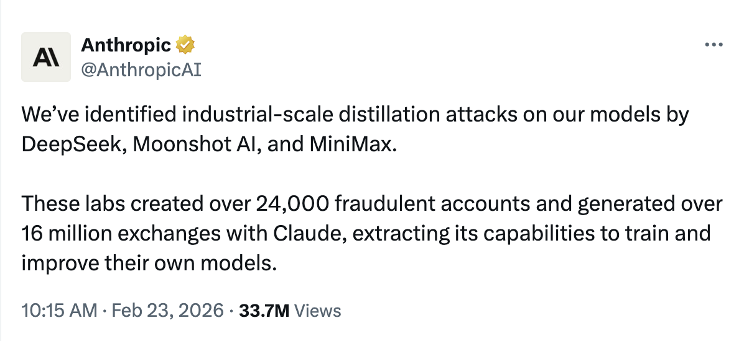
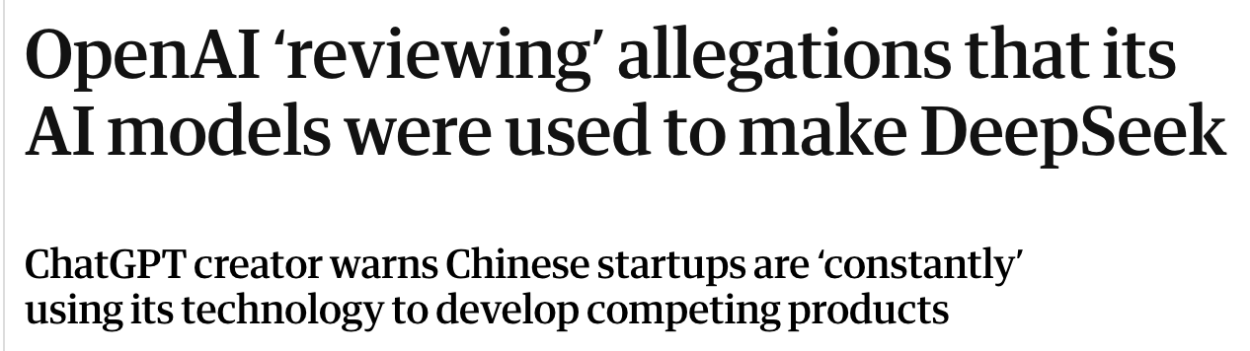
Synthetic Data: Distillation Attacks

Slide 25
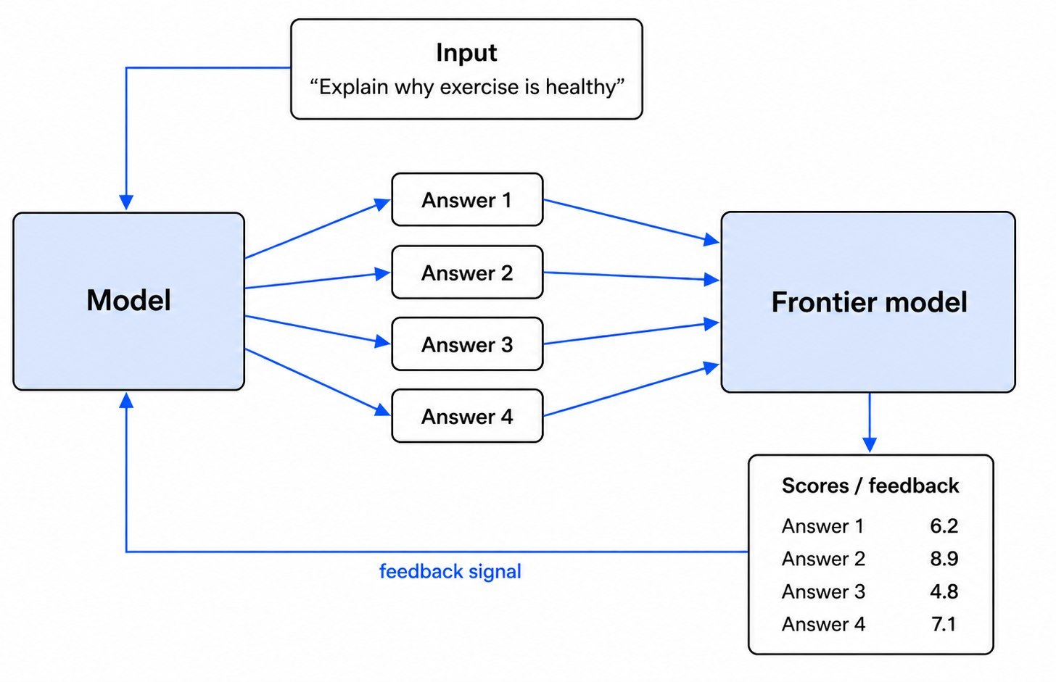
Synthetic Data: LLM-as-Judge
Similar to RLHF, but frontier model generates scores instead of a specialized scoring model

Slide 26
Synthetic Data Summary
 | Distillation | LLM-as-judge
Signal | Teacher's answer | Teacher's score
Who generates data? | Teacher | Student
Teacher needs to… | Answer well | Score well
Cost | Lower | Higher (10x)
Distillation generates training data once and reuses it; one answer per question
Judge-based training needs 10+ answers per question

Slide 27
Reasoning

Slide 28
Reasoning: Chain-of-Thought
Without reasoning: The model immediately provides a final answer.
Chain-of-thought reasoning: The model expresses intermediate reasoning steps before the final answer.
Q
A
Q
step
step
step
A
Chain-of-thought:
Roger starts with 5 balls.
2 cans × 3 balls per can = 6 new balls.
5 + 6 = 11.
Answer:
11
Question:
Roger has 5 tennis balls. He buys 2 more cans of tennis balls. Each can has 3 tennis balls. How many tennis balls does he have now?
Direct answer:
11
Why does reasoning work? The entire sequence is fed back into the model as it is generated, which allows the model to “attend to” the entire output.
Source: Wei et al. (2022), Chain-of-Thought; Wang et al. (2022), Self-Consistency.

Slide 29
Reasoning: Chain-of-Thought
Chain-of-thought means the model generates intermediate reasoning steps before giving a final answer.
Prompting
Training
•
No weight update. The user asks for reasoning, e.g., “think step by step.”
•
Weight update. The model is trained on examples that include intermediate steps.
•
Uses the context window. The reasoning tokens become part of the sequence the model can attend to.
•
Learns a behavior. Hard problems should often use scratch-work before the final answer.
•
Useful at inference time. It can improve hard answers without retraining the model.
•
Can be post-trained. Frontier labs can reward helpful reasoning patterns during post-training.
Same basic idea: spend more tokens on intermediate reasoning before committing to an answer.
Sources: Wei et al. (2022), Chain-of-Thought Prompting; Kojima et al. (2022), Zero-shot Chain-of-Thought.

Slide 30
Reasoning: Self Consistency
Instead of trusting one reasoning path, sample several paths and take the answer that appears most often.
Prompt
same question
Sample paths
different reasoning traces
Vote
majority answer
•
Why it helps. A single reasoning chain can go off track; agreement across multiple chains is a stronger signal.
•
What it costs. If you sample 5 reasoning paths, you may spend roughly 5× more inference tokens.
•
Where it is useful. Math, coding, planning, and other tasks where there is a clear final answer.
Source: Wang et al. (2022), Self-Consistency Improves Chain of Thought Reasoning.

Slide 31
15-min Break

Slide 32
Part 2: Some Economics of AI

Slide 33
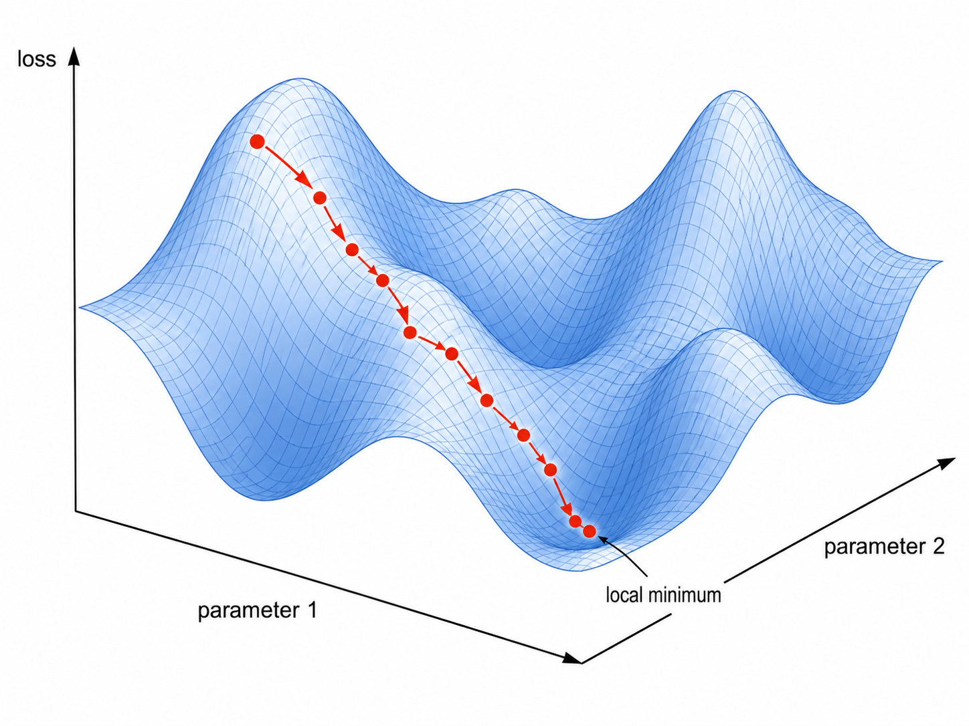
Recap: Graphical Processor Units (GPUs)
Graphical Processor Units (GPUs) are currently at the heart of the AI economy

Slide 34
Follow The Money
End Users / Enterprises
AI Deployers
startups, software firms,
enterprise IT
Frontier Labs
OpenAI, Anthropic,
Google, Meta
subscriptions
inference
inference
at scale
training + inference
compute
GPU Suppliers
NVIDIA, TSMC
Compute Providers
AWS, Azure, Google Cloud
hardware capex
Compute Infrastructure

Slide 35
Cloud GPU Pricing
On-Demand
Reserved
Spot
$3-5/hr
$2-3/hr
$0.50-1.50/hr
Pay by the hour
Used by AI startups, research teams for prototyping and experiments, short training runs, unpredictable workloads
Multi-year commitment Used by large cloud-heavy companies, enterprise AI teams for long-term steady training and inference
Pay by the hour
Used for jobs that can be safely interrupted: model evaluation, synthetic data generation, non-critical tasks
Spot markets exist because big companies buy capacity in advance and want to monetize idle GPUs

Slide 36
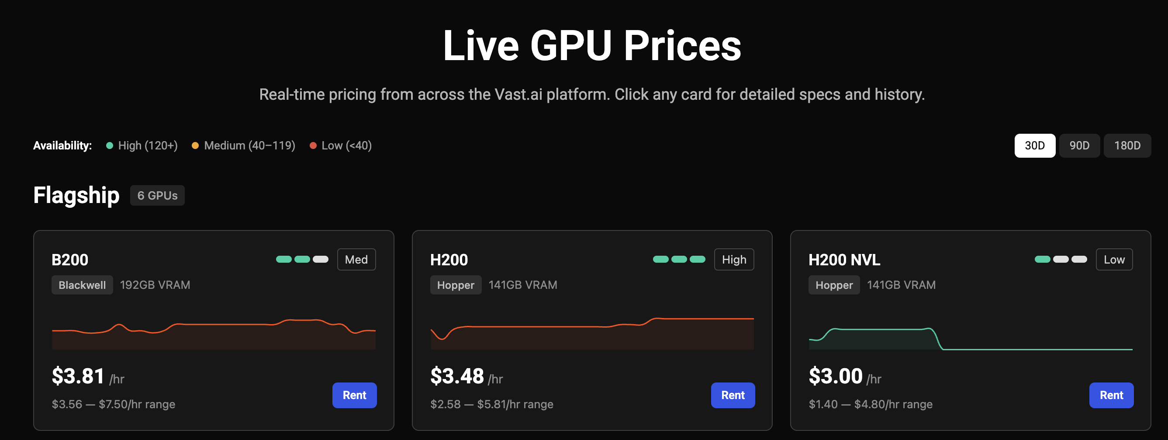
https://vast.ai/pricing

Slide 37
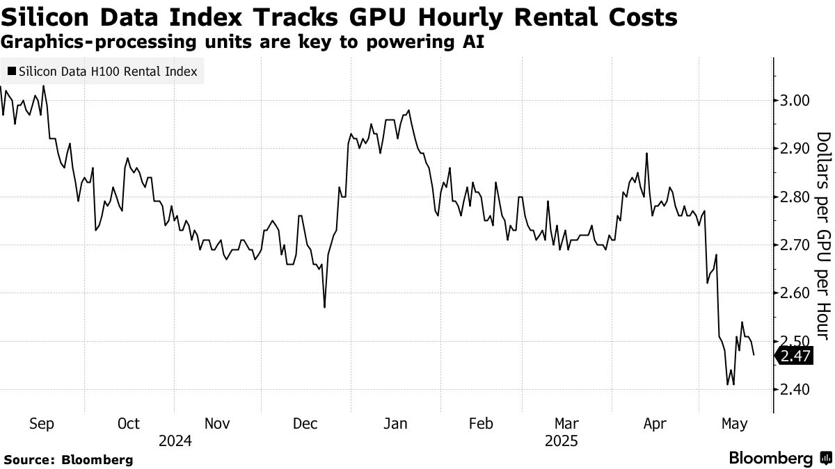

Slide 38
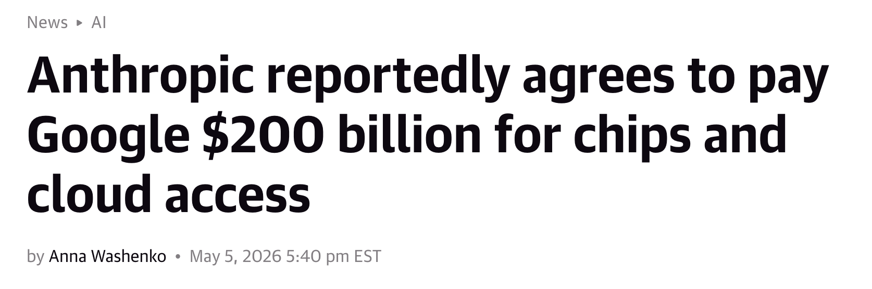
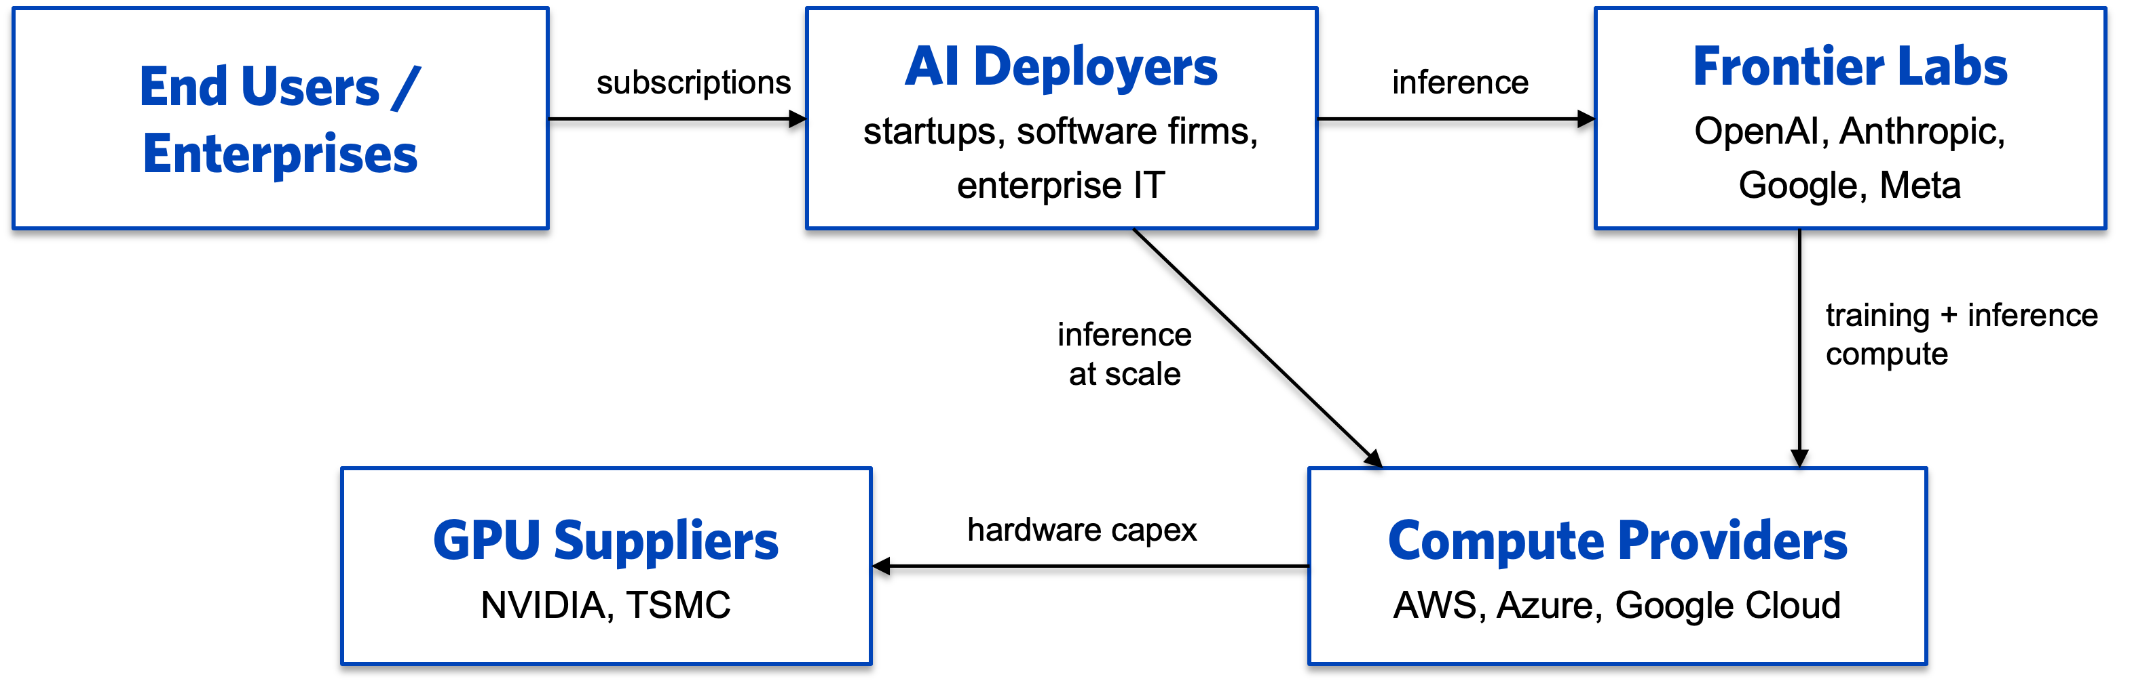
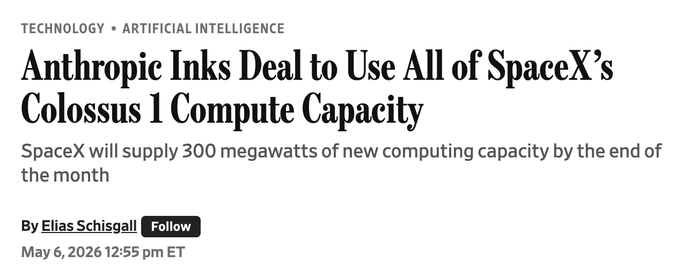
Big Deals
this part

Slide 39
Training Cost Estimates
Training FLOPs ≈ 6 × N × D
N = active parameters D = training tokens
1 FLOP = one Floating Point OPeration (addition or multiplication)
6 x N x D = Forward pass (2) + backward pass (4)
Estimate For Frontier-Scale Models (GPT 5+, Opus 4+)
Parameters (N) = 1 trillion Training tokens (D) = 20 trillion Compute: 1 NVIDIA H100 = 4,000 trillion FLOP/second and 50% effective throughput
Cost of 1 pre-training run = 17 million GPU-hours → $35m (assuming $2/hour rental)
Other training costs: failed runs, experiments, post-training (SFT+RLHF); total R&D may be 5-10x higher (https://epoch.ai/gradient-updates/r-and-d-vs-training-compute)

Slide 40
DeepSeek-V3
DeepSeek-V3 is one of the few large models where all details are published
Metric
DeepSeek-V3
Source
Published technical report
Tokens
14.8T
Compute budget
2.8M GPU-hours (H800s)
Hardware
2,048 NVIDIA H800s
GPU rental
$2/hour
Final run cost
$5.6M
GPT-4
FLOPs
~3e24 from active params × tokens

Slide 41
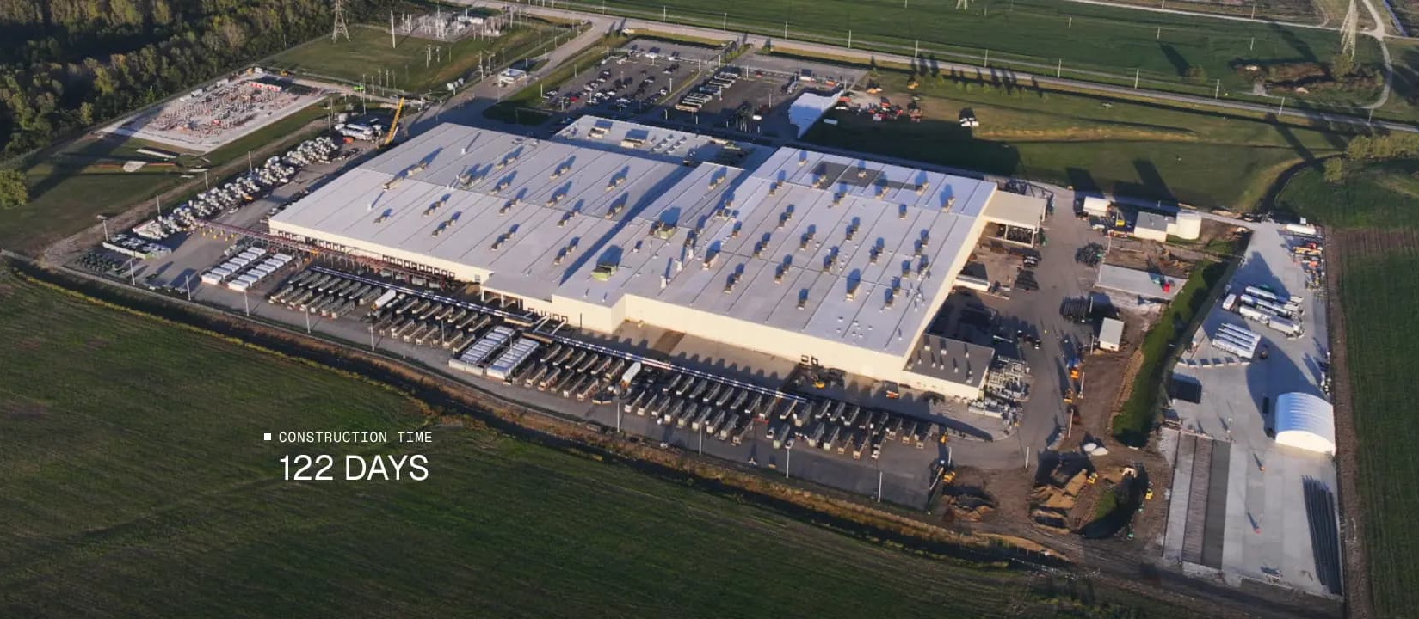

SpaceX’s Colossus 1
220,000 GPUs
(NVIDIA H100s) →
Assuming Anthropic leases from SpaceX at $1/GPU-hour: 220,000 x 24 x 365 x 1 = $1.9b/year for compute
GPT-4

Slide 42
Raw GPU Inference Cost
Inference FLOPs ≈ 2 × N per token
N = active parameters
N
2 X 100B
= 0.00025 sec/token
4,000 TFLOP/s x 20%
H100 peak output
efficiency factor
at $2/GPU-hour → $0.15 per 1M tokens
A casual user: 1M per month; heavy coder 10x; autonomous agent 100x

Slide 43
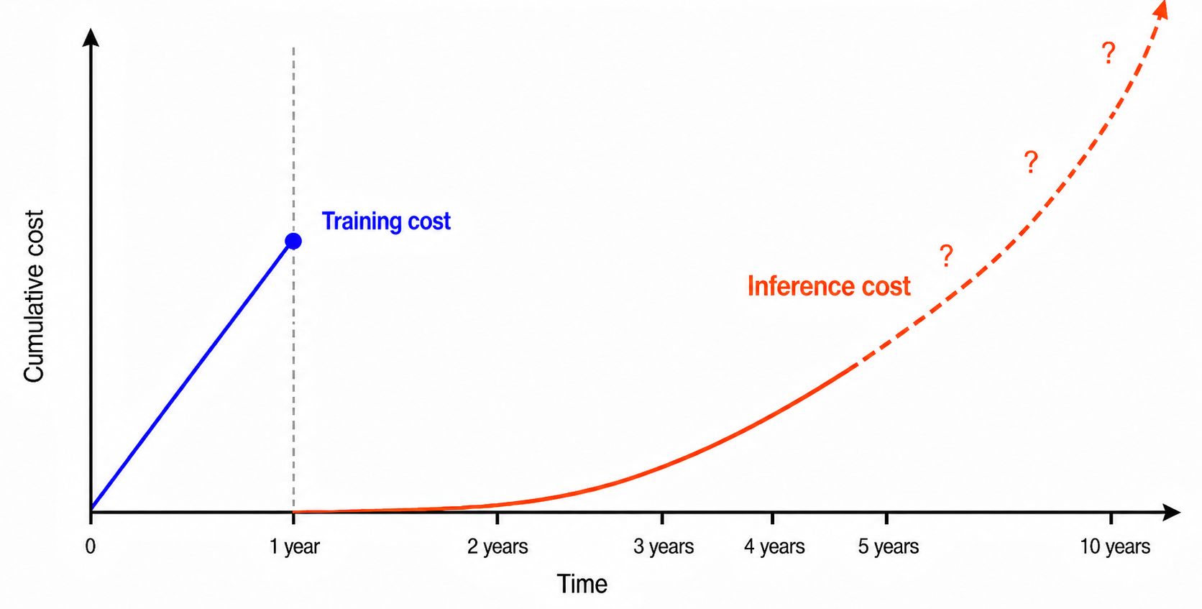
Inference Likely Dominates Lifetime Cost
Training is one-time, inference is ongoing

Slide 44
Mixture-of-Experts (MoE)
Mixture-of-experts transformer dramatically decreases inference cost Used in DeepSeek V3, probably used in most frontier models
raw embeddings
attention head 1
expert 1
raw embeddings
attention head 1
dense layer
router
expert 2
Input tokens
Input tokens
weighted sum
attention head 2
attention head 2
expert 3
expert 256
Classic transformer block: Every token passes through the same dense layer
MoE transformer: dense layer replaced with router + many experts; each token processed by only some experts

Slide 45
API Costs: Token-level Pricing
Model / provider
Input / 1M
Output / 1M
OpenAI GPT-5.4
$2.50
$15
OpenAI GPT-5.5
$5.00
$30
Claude Sonnet 4.5
$3.00
$15
Claude Opus 4.5
$5.00
$25
this part
Sources: OpenAI API pricing; Anthropic Claude pricing docs and launch posts; Claude Code cost docs; TechCrunch reporting on Claude Code rate limits.

Slide 46
Per-Token Pricing Is Falling Fast
API prices for the same intelligence level have dropped steeply over the last few years
Model
Year
Input $/1M tok
Output $/1M tok
GPT-3 davinci
2020
$60
$60
GPT-3.5 turbo
2023
$1.50
$2.00
GPT-4
2023
$30
$60
GPT-4 turbo
2023
$10
$30
GPT-4o
2024
$2.50
$10
GPT-4o mini
2024
$0.15
$0.60
Claude 3.5 Sonnet
2024
$3.00
$15
Gemini 1.5 Flash
2024
$0.075
$0.30
Cost per million tokens for GPT-4-class output: ~$60 → ~$0.60 in two years.

Slide 47
Scaling Laws

Slide 48
Scaling Laws
Scaling is the broad idea that AI performance improves predictably as we increase the computational resources used for training or inference
“resources” can mean:
More compute: more GPU/TPU operations (FLOPs)
More data: more training examples/tokens
More parameters: larger model capacity
More inference-time compute: letting the model reason longer at generation time

Slide 49
Loss Falls Predictably with Compute
Loss falls predictably with compute in controlled scaling-law studies
Some evidence that we’re still scaling as of 2026
https://hai.stanford.edu/ai-index/2026-ai-index-report/technical-performance
The empirical scaling law
loss ≈ A · compute^(−α)
GPT-2
On a log-log plot, loss falls as a straight line with slope −α
test loss (log scale)
GPT-3
PaLM
data not fully public here
GPT-4
frontier 2025-2026
compute used during training (log scale)
Sources: Kaplan et al. (2020), Scaling Laws for Neural Language Models; Hoffmann et al. (2022), Chinchilla.

Slide 50
Chinchilla: Compute-Optimal Training
Same compute budget. Different allocation between model size and training data.
model size / parameters
training data / tokens
Kaplan era (GPT-3, 2020)
more budget into parameters
less data
GPT-3
175B parameters | 300B tokens
Chinchilla
70B parameters | 1.4T tokens
Chinchilla era (2022)
smaller model
much more data
Key idea
For a fixed compute budget, a smaller model trained on much more data can outperform a larger undertrained model.
Chinchilla rule of thumb: roughly 20 training tokens per parameter, though modern models often train with much more data per parameter.
Source: Hoffmann et al. (2022), Training Compute-Optimal Large Language Models.

Slide 51
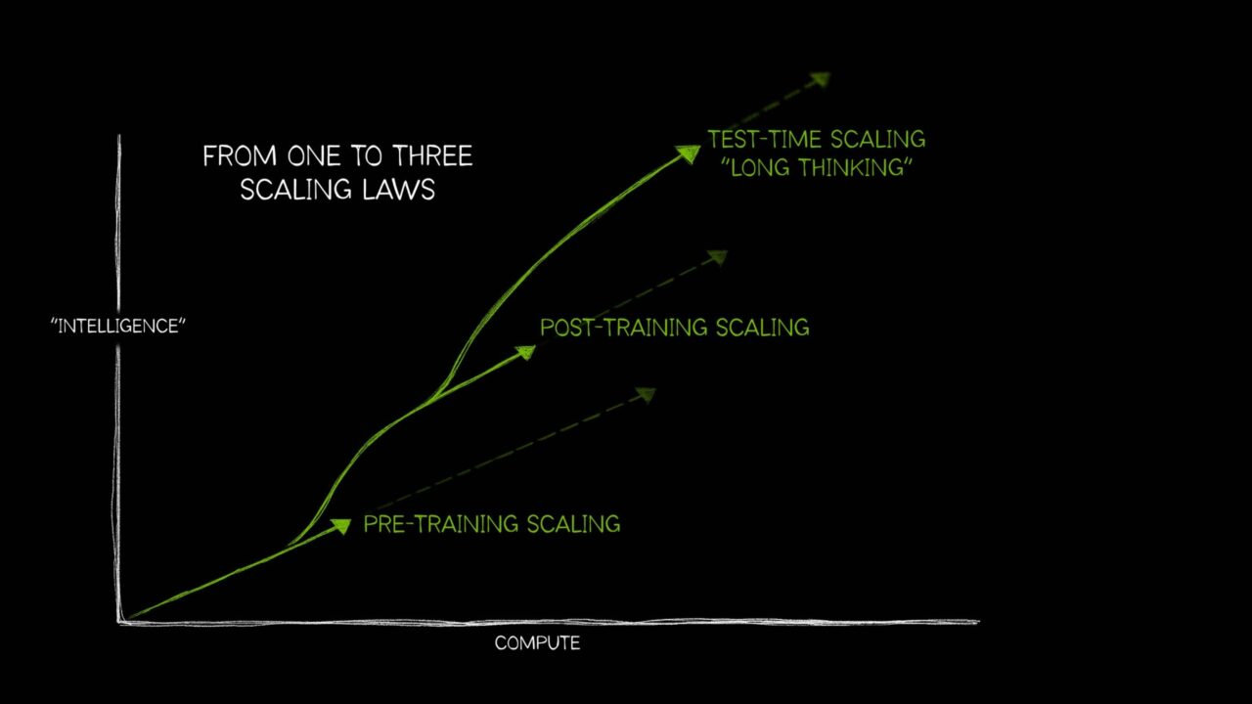
https://blogs.nvidia.com/blog/ai-scaling-laws/

Slide 52
Some Takeaways
•
Scaling laws are predictable, but expensive.
Doubling intelligence is roughly a 10x compute increase. Most of the world won't pay for that themselves.
•
Training cost concentrates the field.
Only 5-10 organizations can afford a frontier run. Expect that list to shrink, not grow.
•
Inference is the real long-run cost.
Deploying an LLM is a stream, not a one-time bill. Costs scale linearly with usage.
•
Per-token prices are falling fast.
10x per year for several years. What's expensive today is commodity in 18 months.
•
NVIDIA holds the picks-and-shovels position.
Most AI revenue today flows through NVIDIA hardware. Watch for the picks-and-shovels economics to be challenged.

Slide 53
Open-Weight Models

Slide 54
Assignment 7

Slide 55
Glossary
Logits
Raw next-token scores produced before softmax converts them into probabilities.
Reward Function
The score r(q, a) the reward model assigns; the optimization target during RLHF.
Temperature
Generation setting that divides logits before softmax; low T sharpens, high T flattens.
RLHF
Reinforcement Learning from Human Feedback. Optimize the LLM as a policy against the RM, KL-regularized to SFT.
Greedy / Sampling
Generation strategies: pick the top token vs. draw from the probability distribution.
Chain-of-Thought
Generating intermediate reasoning steps before the final answer.
SFT
Supervised fine-tuning on prompt-response demonstrations, teaching the model what useful answers look like.
Mixture of Experts
Transformer variant where a router sends each token to a small subset of expert modules.
Catastrophic Forgetting
Fine-tuning damages capabilities the base model previously had.
RAG
Retrieval-Augmented Generation. Retrieve external text and add to the prompt before answering.
Reward Model
Separate neural network trained on human preferences to score (q, a) pairs.
Distillation
Training a smaller student model to imitate outputs from a stronger teacher model.

